Slide 1
College Technical Math 1
Sections 5.1 – 5.4
Operations with Signed Numbers

Slide 2
Essential Question
“Is the application of algebraic concepts a benefit to society?”

Slide 3
Unit 2
5.1 – 5.4: Signed Number Review
5.5/5.6: Powers of 10, Scientific and Engineering Notation
3.1/3.2 (1-3): Percentages and Percentage Problems
3.2(4)/3.3: Percentage Problems, Percent Increase and Decrease Problems

Slide 4





Positive Numbers
$$\{1,2,3,4,5,6,7,8,⋯\}$$
Larger
0 1 2 3 4 5 6 7 8
Smaller
$$>$$
$$6 2$$
$$1 8$$
$$<$$

Slide 5




Negative Numbers
$$\{−1,−2,−3,−4,−5,−6,−7,−8,⋯\}$$
Larger
-8 -7 -6 -5 -4 -3 -2 -1 0
Smaller
$$<$$
$$−6 −2$$
$$−1 −8$$
$$>$$

Slide 6




Integers
$$\{⋯,−5,−4,−3,−2,−1,0,1,2,3,4,5,⋯\}$$
Larger
-5 -4 -3 -2 -1 0 1 2 3 4 5
Smaller
$$−4 1$$
$$<$$
$$−2 −5$$
$$>$$

Slide 7








Graph 4, -3, 2, -5, -8, 0, 6, 7, and -1 on a number line.
-8 -7 -6 -5 -4 -3 -2 -1 0 1 2 3 4 5 6 7 8 9 10
Use the number line to compare each set of integers.
$$−5 −4$$
$$<$$
$$−1 −4$$
$$>$$
$$6 3$$
$$>$$
$$−2 2$$
$$<$$

Slide 8
Absolute Value
The distance a number is from 0 on a number line
The symbol $\left|x\right|$ represents the absolute value of x
The value of an absolute value is a positive number
The Absolute Value of a Number
Example : Find the absolute value of each number
│3 │ | │0 │ | │-6 │ | │- 5 │ | │9│
3
0
6
5
9

Slide 9


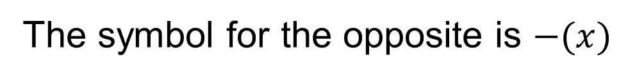
Opposites
Two numbers that are the same distance from zero but on opposite sides of 0
The symbol for the opposite is $−(x)$
Example : Find the opposite of the number
-5 | 3 | 6 | -4
5
$$−3$$
$$−6$$
4

Slide 10



Absolute Values & Opposites
Beware....
Absolute Values
Opposites
$$\left|7\right|=7 \left|−7\right|=7$$
$−\left(7\right)=−7 −\left(−7\right)=7$
Opposite of Absolute Values
$$−\left|7\right|=−7 −\left|−7\right|=−7$$

Slide 11
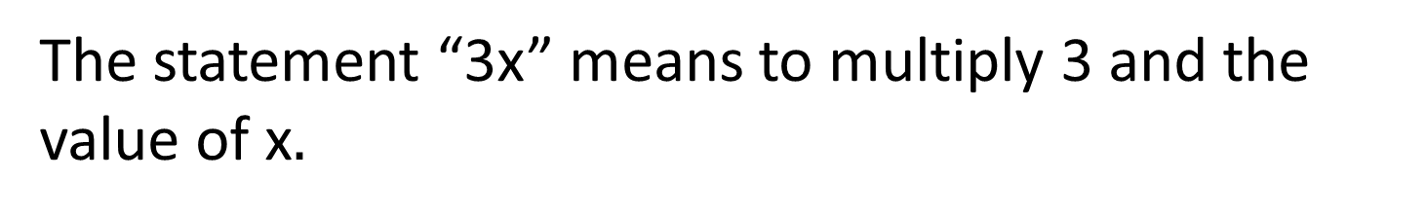
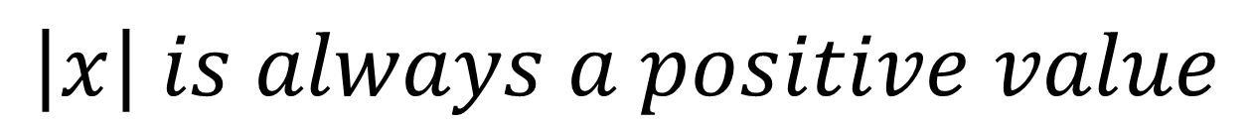
$$\left|x\right| is always a positive value$$
$$−\left|x\right| is always a negative value$$

Slide 12








Simplify each expression. (Example)
$$a) \left|8\right|$$
$$=8$$
$$c) −\left|7\right|$$
$$=−7$$
$$b) −(−3)$$
$$=3$$
$$d) −(2)$$
$$=−2$$

Slide 13








Simplify each expression. (Skill check)
$$a) \left|−9\right|$$
$$=9$$
$$c) −\left|−6\right|$$
$$=−6$$
$$b) −(5)$$
$$=−5$$
$$d) −(−1)$$
$$=1$$

Slide 14


Insert a “>” or “<“ between each pair of numbers to make a true statement. (Skill check)
$$a) −\left|−3\right| < −(−5)$$
$$b) −\left(4\right) < \left|4\right|$$

Slide 15
Adding Integers
1. Start on the number line on the first number
2. Use the second number to determine your direction
a. Adding a positive go right
b. Adding a negative go left
Where you end on the number line is your answer.
-3 + 4 = 1
•
-5
-4
-3
-2
-1
0
1
2
3
4
5

Slide 16
•
-2 + 7 = 5
-5
-4
-3
-2
-1
0
1
2
3
4
5
5 + -4 = 1
•
-5
-4
-3
-2
-1
0
1
2
3
4
5

Slide 17
•
-3 + -2 = -5
-5
-4
-3
-2
-1
0
1
2
3
4
5
1 + -5 = -4
•
-5
-4
-3
-2
-1
0
1
2
3
4
5

Slide 18






Adding integers
To add two numbers with the same signs:
Add their absolute values(distance from 0)
Attach their common sign
$$56 + 23 = ?$$
$$\left(−56\right)+\left(−23\right)= ?$$
$\left|56\right|+\left|23\right|=$
$\left|−56\right| +\left|−23\right|=$
$56 + 23 = 79$
$56 + 23 = 79$
+
-

Slide 19




Adding integers
To add two numbers with the opposite signs:
Subtract the smaller absolute value from the larger one.
Attach the sign of the number with the larger absolute value.
$$92+\left(−41\right)=?$$
$$92−41= 51$$
+
$\left|92\right| =92$
$$\left|−41\right|=41$$

Slide 20
Adding integers
To add two numbers with the opposite signs:
Subtract the smaller absolute value from the larger one.
Attach the sign of the number with the larger absolute value.
$$92−41= 51$$
+
(We have more positive value, 92, than negative value, 41, therefore the sum is positive.)

Slide 21




Adding integers
To add two numbers with the opposite signs:
Subtract the smaller absolute value from the larger one.
Attach the sign of the number with the larger absolute value.
$$−92+41= ?$$
-
$$92−41= 51$$
$\left|−92\right|=92$
$$\left|41\right| =41$$

Slide 22
Adding integers
To add two numbers with the opposite signs:
Subtract the smaller absolute value from the larger one.
Attach the sign of the number with the larger absolute value.
-
$$92−41= 51$$
(We have more negative value, 92, than positive value, 41, therefore the sum is negative.)

Slide 23





Calculate each sum. (Skill Check)
$a) 41+(−16)$
$b) −3+(−19)$
$c) 12+(−33)$
$d) −50+27+\left(−19\right)+86$
$$=25$$
$$=−22$$
$$=−21$$
$$=44$$

Slide 24

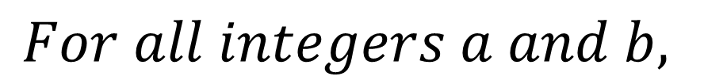
Definition of Subtraction
$$For all integers a and b,$$
$$a−b=a+(−b)$$
Subtraction of an integer is defined as
adding the opposite of the subtrahend(the
value being subtracted)
(The opposite of a positive number is a negative number, the opposite of a negative number is a positive number.)

Slide 25






Calculate each subtraction. (Examples)
$$a) 14−37$$
$$14+(−37)$$
$$−23$$
$$b) −6−15$$
$$−6+(−15)$$
$$−21$$

Slide 26






Calculate each subtraction. (Examples)
$$c) 22−(−7)$$
$$22+(+7)$$
$$29$$
$$d) −11−(−42)$$
$$−11+(+42)$$
$$31$$

Slide 27






Calculate each subtraction. (Skill Check)
$$a) 9−33$$
$$9+(−33)$$
$$−24$$
$$b) −15−108$$
$$−15+(−108)$$
$$−123$$

Slide 28






Calculate each subtraction. (Skill Check)
$$c) 4−(−56)$$
$$4+(+56)$$
$$60$$
$$d) −94−(−53)$$
$$−94+(+53)$$
$$−41$$

Slide 29
Remembering Integer Addition
and Subtraction
“Same sign, keep and add,
Different signs subtract,
Keep the sign of the bigger number,
And then you’ll be exact!”
(Sung to the melody of “Row, row, row your boat”)
http://www.youtube.com/watch?v=Xxi4ItFpUvw&feature=related

Slide 30




Multiplication of integers
Product of two factors with the same sign is positive.
$$\left(+\right)\left(+\right)=+$$
$$\left(−\right)\left(−\right)=+$$
$$6\left(5\right)=30$$
$$\left(−9\right)\left(−2\right)=18$$

Slide 31


Extension: If there are an even number of negative
factors, then the product will be positive.
1
2
3
4
$$3(−2)(−2)(−1)(−4)$$
Since there are an even number of negative factors,
the product will be positive.
$$3\left(−2\right)\left(−2\right)\left(−1\right)\left(−4\right)=48$$

Slide 32




Multiplication of integers
Product of two factors with different signs is
negative.
$$\left(+\right)\left(−\right)=−$$
$$\left(−\right)\left(+\right)=−$$
$$6\left(−5\right)=−30$$
$$\left(−9\right)\left(2\right)=−18$$

Slide 33


Extension: If there are an odd number of negative
factors, then the product will be negative.
1
2
3
$$3(−2)(2)(−1)(−4)$$
Since there are an odd number of negative factors,
the product will be negative.
$$3\left(−2\right)\left(2\right)\left(−1\right)\left(−4\right)=−48$$

Slide 34







Determine the product. (Example)
$$a) 5(−3)$$
$$=−15$$
$$b) (−3)(−6)$$
$$=18$$
$$c) 4(8)$$
$$=32$$
$$d) 2(−3)(−2)(−4)$$
$$=−48$$

Slide 35








Determine the product. (Skill Check)
$$a) 7(6)$$
$$=42$$
$$b) (−5)(6)$$
$$=−30$$
$$c) 10(−8)$$
$$=−80$$
$$d) (−2)(2)(−1)(3)$$
$$=12$$

Slide 36


Exponents with integers
exponent
$${\left(−2\right)}^{4}$$
This means that the $(−2)$ is a factor
4 times.
base
$${\left(−2\right)}^{4}=\left(−2\right)\left(−2\right)\left(−2\right)\left(−2\right)=16$$

Slide 37
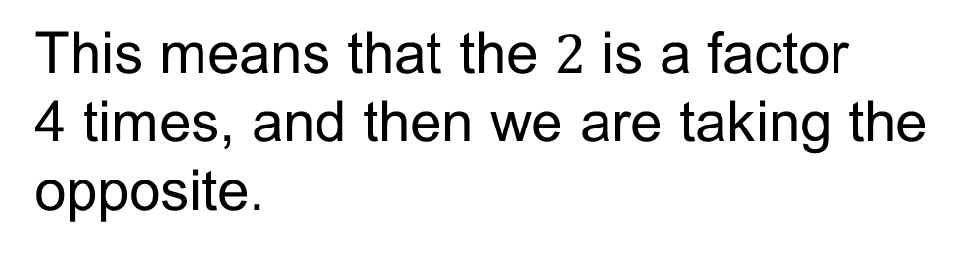


Exponents with integers
exponent
$${−2}^{4}$$
This means that the $2$ is a factor
4 times, and then we are taking the
opposite.
base
(only the 2)
$${−2}^{4}=−\left(2∙2∙2∙2\right)=−16$$

Slide 38








Simplify each exponential expression. (Example)
$$a) {\left(−3\right)}^{2}$$
$$c) {−4}^{2}$$
$$\left(−3\right)\left(−3\right)=9$$
$$−\left(4∙4\right)=−16$$
$$b) {\left(−2\right)}^{3}$$
$$d) {−5}^{3}$$
$$\left(−2\right)\left(−2\right)\left(−2\right)=−8$$
$$−\left(5∙5∙5\right)=−125$$

Slide 39








Simplify each exponential expression. (Skill check)
$$a) {\left(−6\right)}^{2}$$
$$c) {−5}^{2}$$
$$\left(−6\right)\left(−6\right)=36$$
$$−\left(5∙5\right)=−25$$
$$b) {\left(−3\right)}^{3}$$
$$d) {−3}^{3}$$
$$\left(−3\right)\left(−3\right)\left(−3\right)=−27$$
$$−\left(3∙3∙3\right)=−27$$

Slide 40
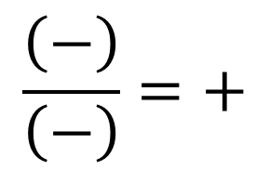
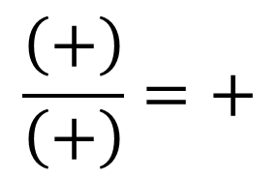
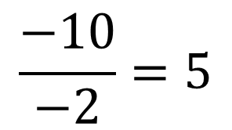
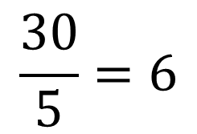
division of integers
Quotient of two numbers with the same sign is positive.
$$\frac{\left(+\right)}{\left(+\right)}=+$$
$$\frac{\left(−\right)}{\left(−\right)}=+$$
$$\frac{30}{5}=6$$
$$\frac{−10}{−2}=5$$

Slide 41
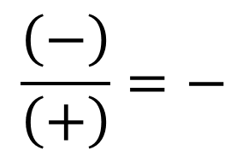
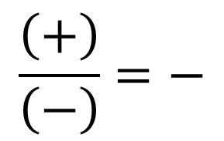
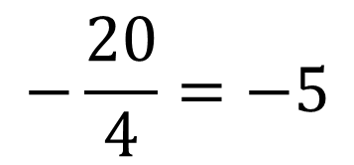
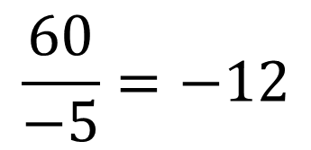
Division of integers
Quotient of two numbers with different signs is
negative.
$$\frac{\left(+\right)}{\left(−\right)}=−$$
$$\frac{\left(−\right)}{\left(+\right)}=−$$
$$\frac{60}{−5}=−12$$
$$−\frac{20}{4}=−5$$

Slide 42







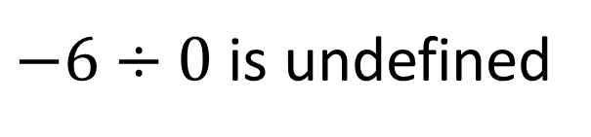
Determine each quotient. (Example)
$$a) 18÷(−6)$$
$$c) −15÷(−3)$$
$$18÷\left(−6\right)=−3$$
$$−15÷\left(−3\right)=5$$
$$b) (−24)÷6$$
$$d) −6÷0$$
$$\left(−24\right)÷6=−4$$
$−6÷0$ is undefined

Slide 43








Determine each quotient. (Skill check)
$$a) −12÷(−6)$$
$$c) 24÷(−8)$$
$$−12÷\left(−6\right)=2$$
$$24÷\left(−8\right)=−3$$
$$b) 30÷6$$
$$d) −6÷(−6)$$
$$30÷6=5$$
$$−6÷\left(−6\right)=1$$

Slide 44
P
- Simplify the expressions in parentheses.
E
- Simplify the values with exponents.
M
Simplify the multiplications.
D
L R
Simplify the divisions.
A
Simplify the additions.
S
L R
Simplify the subtractions.

Slide 45





Order of Operations
Use the order of operations to simplify each expression. (Skill Check)
$$a) −5+3(9−16)$$
$$−5+3(9+\left(−16\right))$$
$$−5+3(−7)$$
$$−5+(−21)$$
$$−26$$

Slide 46






Order of Operations
Use the order of operations to simplify each expression. (Skill Check)
$$b) 18÷\left(−3\right)−5(−6+2)$$
$$18÷\left(−3\right)−5(−4)$$
$$−6−5(−4)$$
$$−6−(−20)$$
$$−6+(+20)$$
$$14$$

Slide 47







Order of Operations
Use the order of operations to simplify each expression. (Skill Check)
$$c) −4^{2}+3(−7−1)÷(−2)$$
$$−42+ 3\left(−8\right) ÷(−2)$$
$$−42+ 3\left(−8\right) ÷(−2)$$
$$−16+3(−8)÷(−2)$$
$$−16+(−24)÷(−2)$$
$$−16+12$$
$$=−4$$

Slide 48








$$Real$$
$$Rational$$
$$Irrational$$
$$Integers$$
$$Whole$$
$$Natural$$
$$Imaginary$$
$$Complex$$
The rules for the operations on signed numbers apply to all of the number sets!

Slide 49
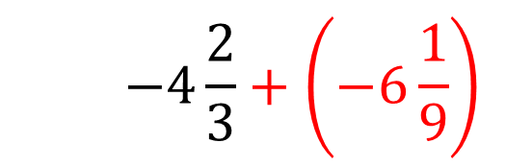
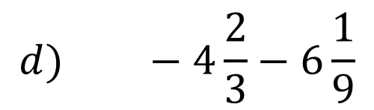
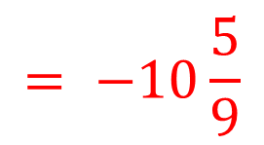
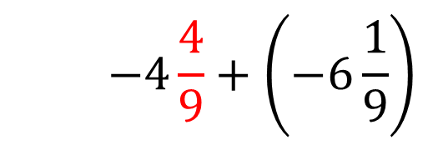
Order of Operations
Use the order of operations to simplify each expression. (Skill Check)
$$d) −4\frac{2}{3}−6\frac{1}{9}$$
$$−4\frac{2}{3}+\left(−6\frac{1}{9}\right)$$
$$−4\frac{4}{9}+\left(−6\frac{1}{9}\right)$$
$$= −10\frac{5}{9}$$

Slide 50
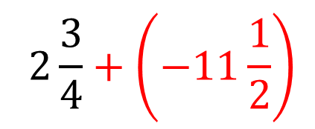
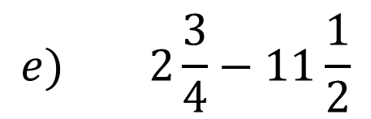
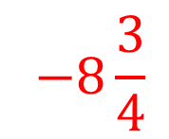
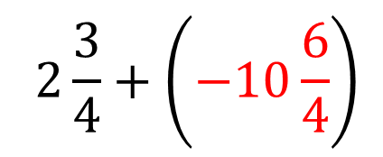
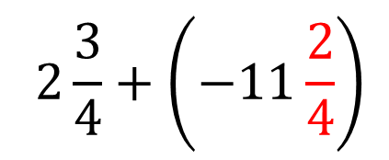
Order of Operations
Use the order of operations to simplify each expression. (Skill Check)
$$e) 2\frac{3}{4}−11\frac{1}{2}$$
$$2\frac{3}{4}+\left(−10\frac{6}{4}\right)$$
$$2\frac{3}{4}+\left(−11\frac{1}{2}\right)$$
$$−8\frac{3}{4}$$
$$2\frac{3}{4}+\left(−11\frac{2}{4}\right)$$

Slide 51
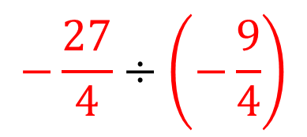
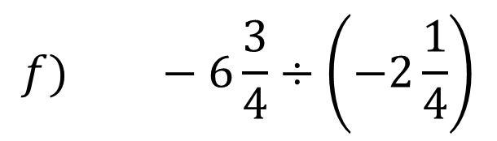

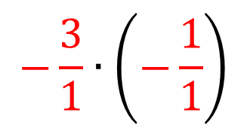
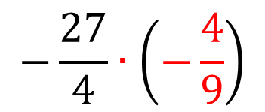
Order of Operations
Use the order of operations to simplify each expression. (Skill Check)
$$f) −6\frac{3}{4}÷\left(−2\frac{1}{4}\right)$$
$$−\frac{3}{1}∙\left(−\frac{1}{1}\right)$$
$$−\frac{27}{4}÷\left(−\frac{9}{4}\right)$$
$$3$$
$$−\frac{27}{4}∙\left(−\frac{4}{9}\right)$$

Slide 52
Unit 2
5.1 – 5.4: Signed Number Review
5.5/5.6: Powers of 10, Scientific and Engineering Notation
3.1/3.2 (1-3): Percentages and Percentage Problems
3.2(4)/3.3: Percentage Problems, Percent Increase and Decrease Problems

